Slide 1

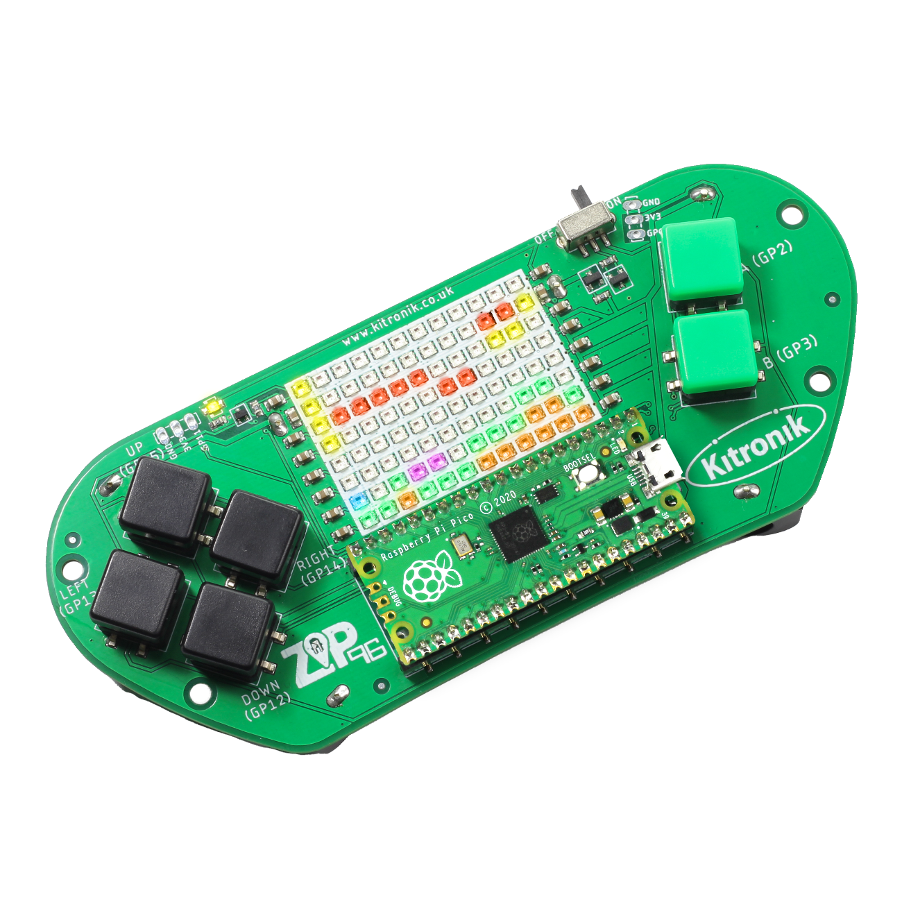
creating the a-mazing game
Computer Science

Slide 2

Aims & objectives
Computer Science
By the end of this lesson you will have:
Explored a basic search algorithm.
Written pseudocode for a search algorithm.
Explored insertion sort.

Slide 3
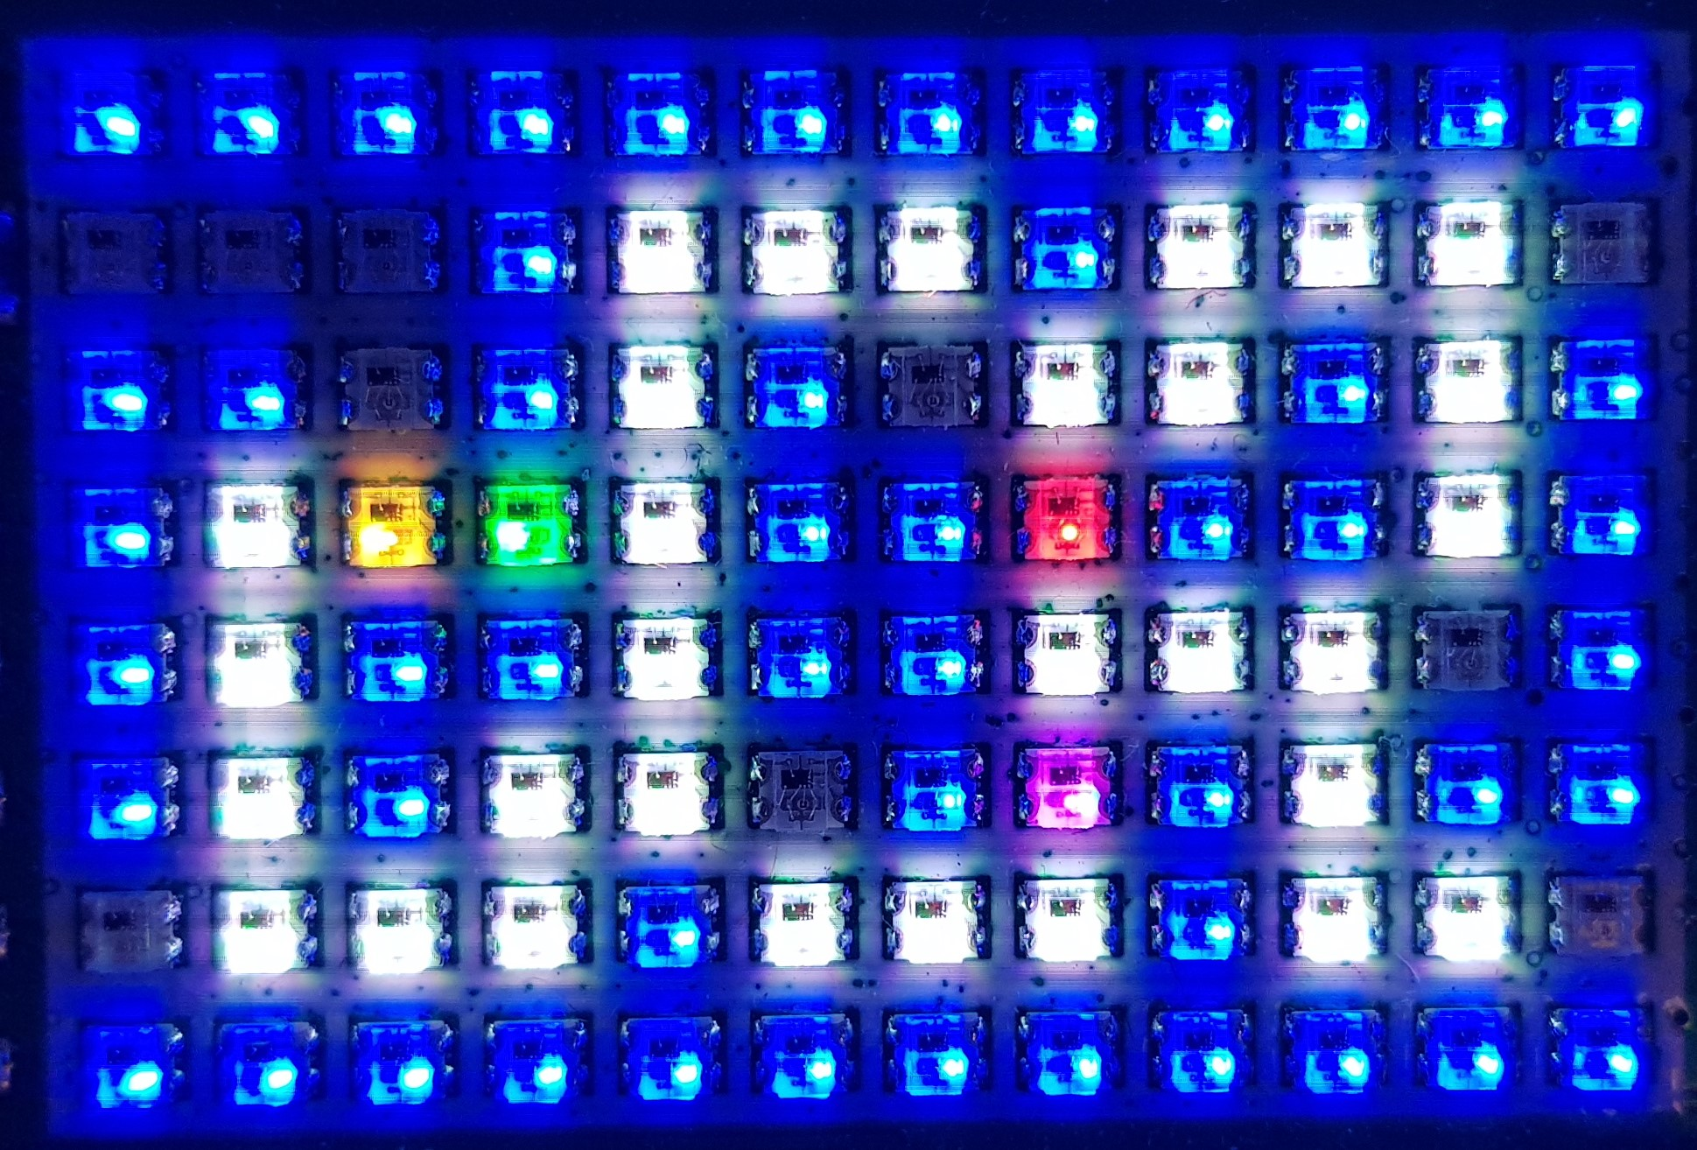
What is our a-mazing game?
Computer Science
A maze-based game where the player runs through a maze collecting gems – collect all the gems to win.
Three different enemies move around the maze as well, trying to stop the player from collecting gems.
One enemy moves randomly, one simply tries to move towards the player, the final one is smart and finds the best path through the maze to the player.
If an enemy catches the player, they lose a life. Once all three lives are lost… game over!

Slide 4
What is a search algorithm?
Computer Science
The general idea is to check all of the directions we can move from a given starting position.
Pretend to move in each of these directions and see if we can reach the given destination.
If one of these is the destination, move that way straight to the destination.
If none of these is the destination, add them to a list, and perform the same process just carried out on each of these new positions.
As each stage is repeated, record how many moves are being made.
Once the destination has been located, see which route took the shortest number of moves, and then use that one.

Slide 5
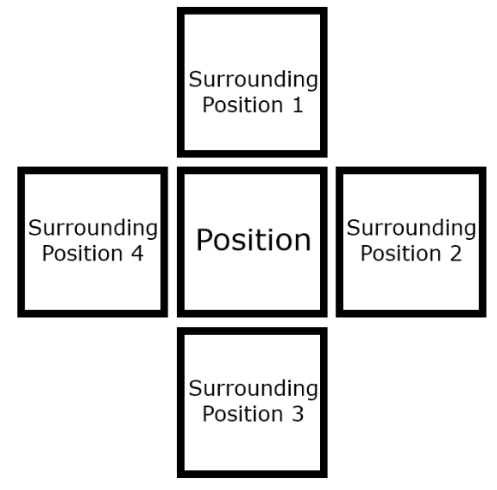
Possible move locations
Computer Science

Slide 6

Where to start?
Computer Science
Where should the algorithm start searching from – the player’s position or the enemy’s? What are the reasons for your answer?

Slide 7
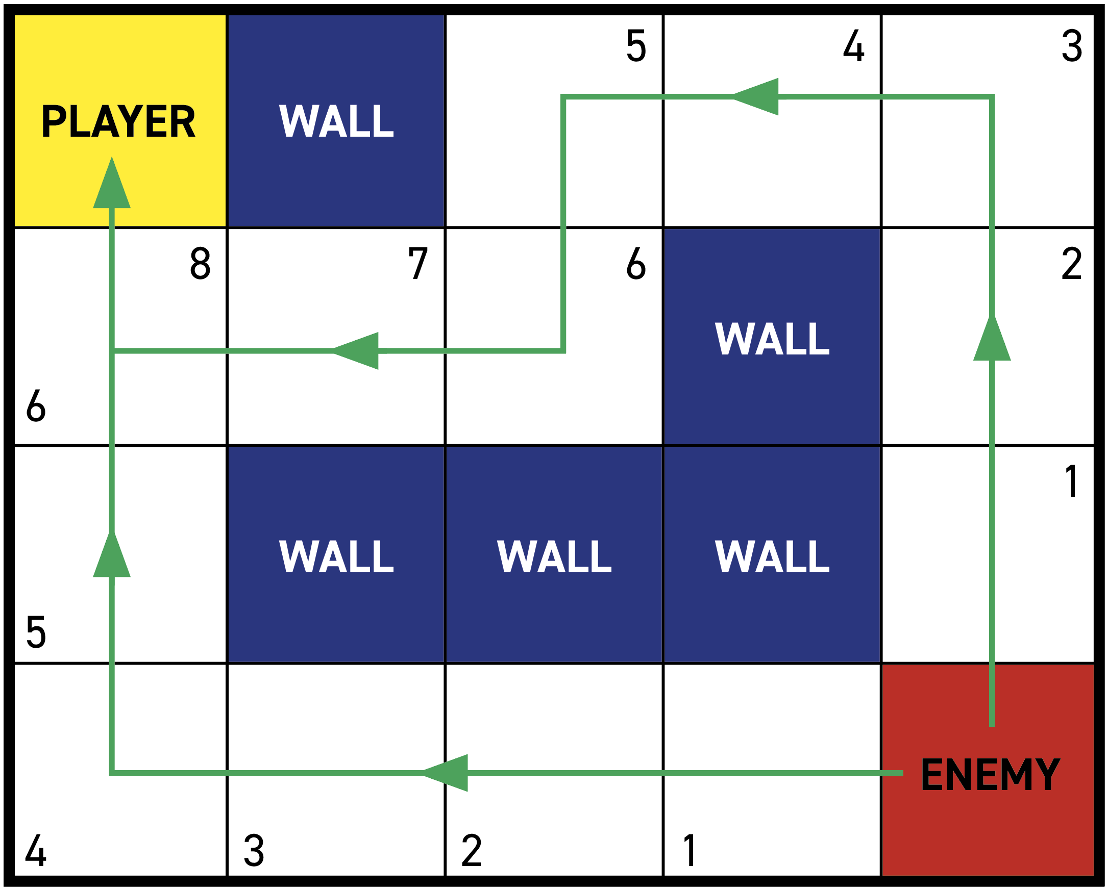
Start from the enemy
Computer Science

Slide 8

Start from the player
Computer Science

Slide 9
Algorithm pseudocode
Computer Science
Create array toVisit of positions to visit
Create 2D array visited of positions visited
Add the start position to the toVisit array
While there are still positions in toVisit:
set visiting as the position at end of the toVisit array and remove it from the array
add the visiting position to the visited array
if visiting is our destination position:
leave the loop
check the positions surrounding visiting as surrounding:
if we have not visited surrounding before:
add surrounding to the toVisit array with a distance travelled of visiting distance travelled + 1
Check the positions surrounding the start position for the shortest distance travelled and move to that position

Slide 10
Algorithm step 1
Computer Science
Create array toVisit of positions to visit
Create 2D array visited of positions visited
Add the start position to the toVisit array
While there are still positions in toVisit:
set visiting as the position at end of the toVisit array and remove it from the array
add the visiting position to the visited array
if visiting is our destination position:
leave the loop
check the positions surrounding visiting as surrounding:
if we have not visited surrounding before:
add surrounding to the toVisit array with a distance travelled of visiting distance travelled + 1
Check the positions surrounding the start position for the shortest distance travelled and move to that position
Create array toVisit of positions to visit

Slide 11
Algorithm step 2
Computer Science
Create array toVisit of positions to visit
Create 2D array visited of positions visited
Add the start position to the toVisit array
While there are still positions in toVisit:
set visiting as the position at end of the toVisit array and remove it from the array
add the visiting position to the visited array
if visiting is our destination position:
leave the loop
check the positions surrounding visiting as surrounding:
if we have not visited surrounding before:
add surrounding to the toVisit array with a distance travelled of visiting distance travelled + 1
Check the positions surrounding the start position for the shortest distance travelled and move to that position
Create 2D array visited of positions visited

Slide 12
Algorithm step 3
Computer Science
Create array toVisit of positions to visit
Create 2D array visited of positions visited
Add the start position to the toVisit array
While there are still positions in toVisit:
set visiting as the position at end of the toVisit array and remove it from the array
add the visiting position to the visited array
if visiting is our destination position:
leave the loop
check the positions surrounding visiting as surrounding:
if we have not visited surrounding before:
add surrounding to the toVisit array with a distance travelled of visiting distance travelled + 1
Check the positions surrounding the start position for the shortest distance travelled and move to that position
Add the start position to the toVisit array

Slide 13
Algorithm step 4
Computer Science
Create array toVisit of positions to visit
Create 2D array visited of positions visited
Add the start position to the toVisit array
While there are still positions in toVisit:
set visiting as the position at end of the toVisit array and remove it from the array
add the visiting position to the visited array
if visiting is our destination position:
leave the loop
check the positions surrounding visiting as surrounding:
if we have not visited surrounding before:
add surrounding to the toVisit array with a distance travelled of visiting distance travelled + 1
Check the positions surrounding the start position for the shortest distance travelled and move to that position
While there are still positions in toVisit:

Slide 14
Algorithm step 5
Computer Science
Create array toVisit of positions to visit
Create 2D array visited of positions visited
Add the start position to the toVisit array
While there are still positions in toVisit:
set visiting as the position at end of the toVisit array and remove it from the array
add the visiting position to the visited array
if visiting is our destination position:
leave the loop
check the positions surrounding visiting as surrounding:
if we have not visited surrounding before:
add surrounding to the toVisit array with a distance travelled of visiting distance travelled + 1
Check the positions surrounding the start position for the shortest distance travelled and move to that position
set visiting as the position at end of the toVisit array and remove it from the array

Slide 15
Algorithm step 6
Computer Science
Create array toVisit of positions to visit
Create 2D array visited of positions visited
Add the start position to the toVisit array
While there are still positions in toVisit:
set visiting as the position at end of the toVisit array and remove it from the array
add the visiting position to the visited array
if visiting is our destination position:
leave the loop
check the positions surrounding visiting as surrounding:
if we have not visited surrounding before:
add surrounding to the toVisit array with a distance travelled of visiting distance travelled + 1
Check the positions surrounding the start position for the shortest distance travelled and move to that position
add the visiting position to the visited array

Slide 16
Algorithm step 7
Computer Science
Create array toVisit of positions to visit
Create 2D array visited of positions visited
Add the start position to the toVisit array
While there are still positions in toVisit:
set visiting as the position at end of the toVisit array and remove it from the array
add the visiting position to the visited array
if visiting is our destination position:
leave the loop
check the positions surrounding visiting as surrounding:
if we have not visited surrounding before:
add surrounding to the toVisit array with a distance travelled of visiting distance travelled + 1
Check the positions surrounding the start position for the shortest distance travelled and move to that position
if visiting is our destination position:
leave the loop

Slide 17
Algorithm step 8
Computer Science
Create array toVisit of positions to visit
Create 2D array visited of positions visited
Add the start position to the toVisit array
While there are still positions in toVisit:
set visiting as the position at end of the toVisit array and remove it from the array
add the visiting position to the visited array
if visiting is our destination position:
leave the loop
check the positions surrounding visiting as surrounding:
if we have not visited surrounding before:
add surrounding to the toVisit array with a distance travelled of visiting distance travelled + 1
Check the positions surrounding the start position for the shortest distance travelled and move to that position
check the positions surrounding visiting as surrounding:

Slide 18
Algorithm step 9
Computer Science
Create array toVisit of positions to visit
Create 2D array visited of positions visited
Add the start position to the toVisit array
While there are still positions in toVisit:
set visiting as the position at end of the toVisit array and remove it from the array
add the visiting position to the visited array
if visiting is our destination position:
leave the loop
check the positions surrounding visiting as surrounding:
if we have not visited surrounding before:
add surrounding to the toVisit array with a distance travelled of visiting distance travelled + 1
Check the positions surrounding the start position for the shortest distance travelled and move to that position
if we have not visited surrounding before:
add surrounding to the toVisit array with a distance travelled of visiting distance travelled + 1

Slide 19
Algorithm step 10
Computer Science
Create array toVisit of positions to visit
Create 2D array visited of positions visited
Add the start position to the toVisit array
While there are still positions in toVisit:
set visiting as the position at end of the toVisit array and remove it from the array
add the visiting position to the visited array
if visiting is our destination position:
leave the loop
check the positions surrounding visiting as surrounding:
if we have not visited surrounding before:
add surrounding to the toVisit array with a distance travelled of visiting distance travelled + 1
Check the positions surrounding the start position for the shortest distance travelled and move to that position
Check the positions surrounding the start position for the shortest distance travelled and move to that position

Slide 20
conclusion
Computer Science
In this lesson you have:
Discussed how arrays and 2D arrays can be used.
Created pseudocode for a basic 2D search algorithm.
Explained insertion sort.
Explained a basic 2D search algorithm.

